Slide 1
Computer Architecture & Assembly Language CSC-250
COURSE LECTURE
COMPUTER SCIENCE DEPARTMENT
SIBAU KANDHKOT CAMPUS

Slide 2
History of computer
MECHANICAL
ELOCTRO MECHANICAL
ELECTRONIC

Slide 3
ENIAC
Electronic Numerical Integrator And Computer
Decimal (not binary)
20 accumulators of 10 digits (ACCUMULATOR:
Programmed manually by switches
18,000 vacuum tubes
30 tons
15,000 square feet
140 kW power consumption
5,000 additions per second
An accumulator is a register for short-term, intermediate storage of arithmetic and logic data in a computer's CPU The term "accumulator" is rarely used in reference to contemporary CPUs, having been replaced around the turn of the millennium by the term "register." In a modern computers, any register can function as an accumulator
First Task was to check feasibility of hydrogen bomb through experiments
Used until 1955

Slide 4
von Neumann/Turing
Stored Program concept
Main memory storing programs and data
ALU operating on binary data
Control unit interpreting instructions from memory and executing
Input and output equipment operated by control unit
Princeton Institute for Advanced Studies (IAS) computer
Completed 1952

Slide 5
Structure of von Neumann machine

Slide 6
John von Neumann and the IAS machine, 1952

Slide 7
Word
IAS contains 1000 storage locations:
Each called a word (40 Binary Digits)
Store Data and Instructions

Slide 8
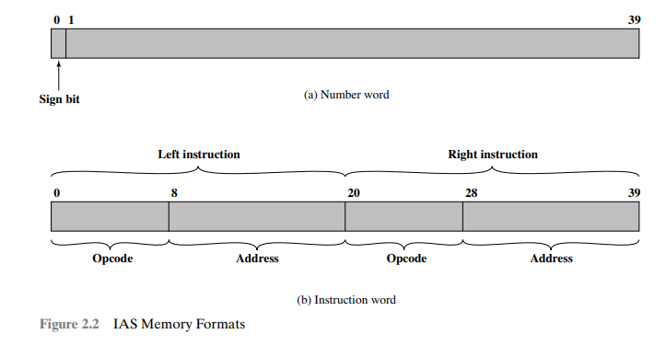
IAS Memory Formats

Slide 9
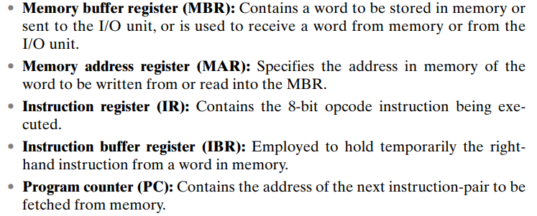
Registers

Slide 10
IAS Operation
Operates by repetitively performing an instruction cycle
Fetch
Opcode of next instruction is loaded in IR
Address portion is loaded in MAR
Execute
Interpretation of OPCODE
Control signals are sent to ALU to execute

Slide 11
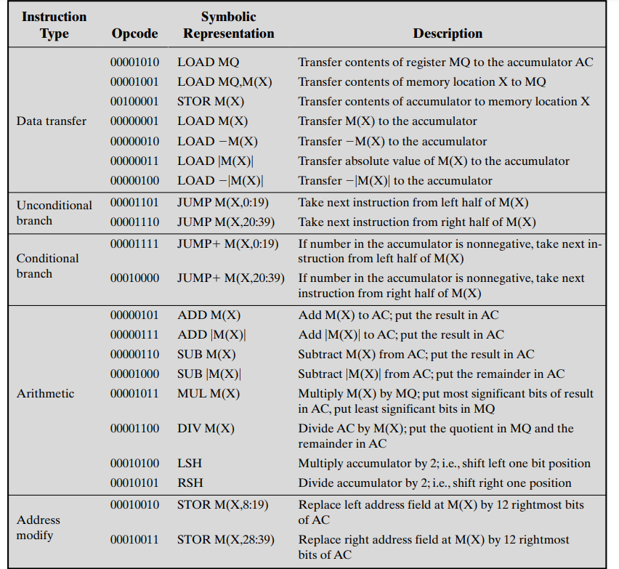
IAS Instructions
21 Instructions

Slide 12
Commercial Computers
UNIVAC I(Universal Automatic Computer):
First Commercial computer
US Bureau of Census for the 1950 calculations
Late 1950s -UNIVAC II
—Faster
—More memory
Every organization makes backward compatible PCs:
Clients always try to buy from the same vendor
No Loss in purchase of software programs

Slide 13
IBM (International Business Machines Corporation)
1953 -the 701
IBM’s first stored program computer
Scientific calculations
1955 -the 702
Business applications
Made IBM Dominant manufacturer

Slide 14
Transistors
Replaced vacuum tubes
Smaller
Cheaper
Less heat dissipation
Solid State device
Made from Silicon (Sand)
Invented 1947 at Bell Labs

Slide 15
Transistor Based Computers
Second generation machines
High Level Languages, System Software
NCR & RCA produced small transistor machines
IBM 7000
DEC - 1957
Produced PDP-1

Slide 16
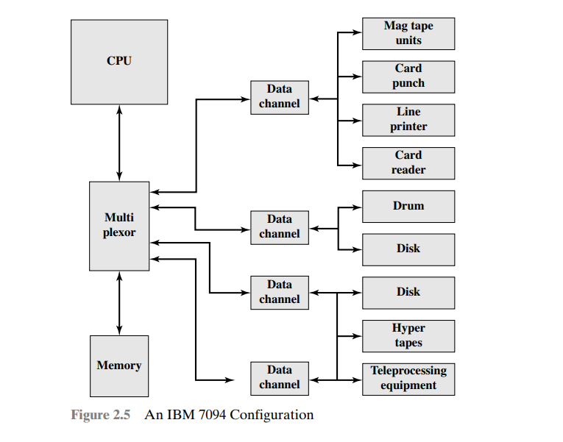
THE IBM 7094

Slide 17
Third Generation
Number of Transistors were growing in PCS:
Lead to larger size:
Affected Speed
Development of Microelectronics

Slide 18
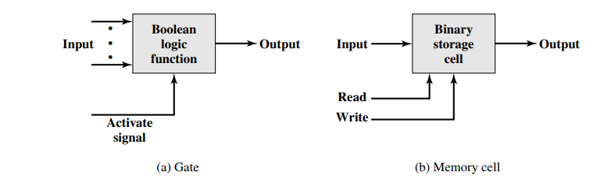
Microelectronics
Literally - “small electronics”
A computer performs data processing, data control, I/O etc:
Gates, memory cells are enough
These can be manufactured on a semiconductor
e.g. silicon wafer (SSI)

Slide 19
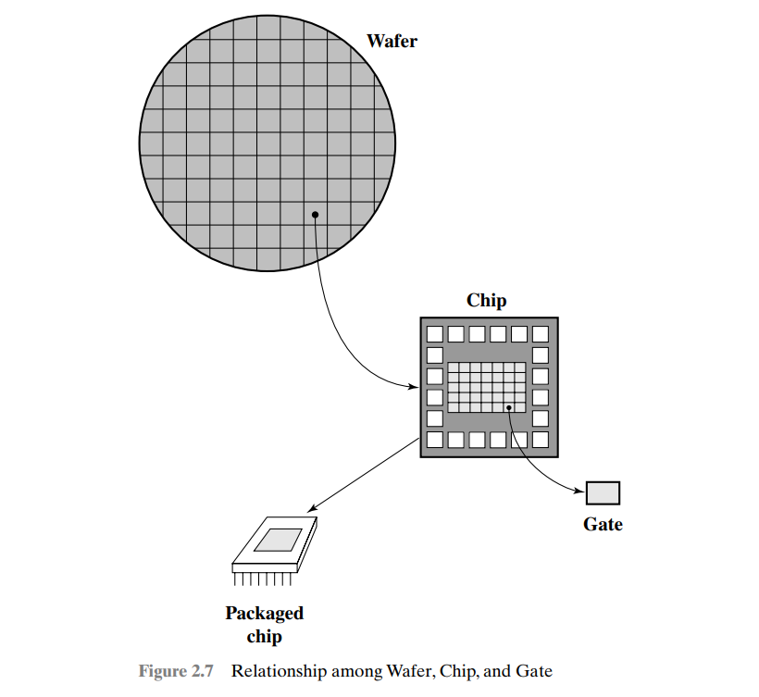
WAFER

Slide 20
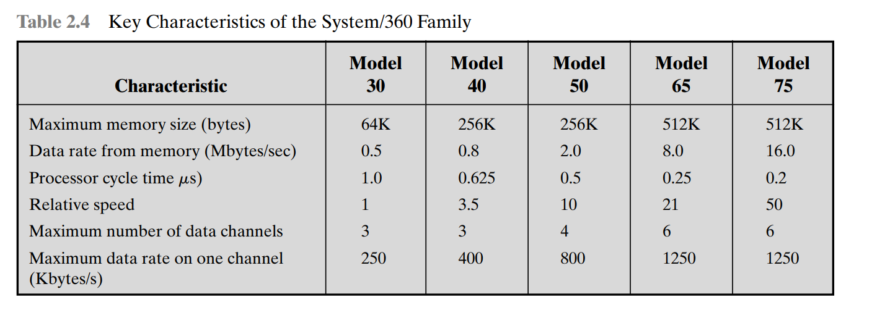
IBM 360

Slide 21
Characteristics of Family
Similar or Identical Instruction set:
Almost same machine instructions
Programs can run on any machine of family
Similar or Identical OS:
Same OS
Additional features
Going up:
Increasing Speed
Increasing I/O Ports
Increasing Memory Size
Increasing Cost

Slide 22
DEC PDP-8
Same year(IBM system/360) –PDP-8 from Digital Equipment Corporation
Small enough to be placed on top of bench
No air-conditioned room required
Cheap enough (Not exact functionality like mainframe)
No central switch architecture (Fig.1.9) IBM
Introduced the concept of Omnibus( Bus structure for microcomputers)

Slide 23
Generations of Computers
Vacuum tube -1946-1957
Transistor -1958-1964
Small scale integration -1965 on
Up to 100 devices on a chip
Medium scale integration -to 1971
100-3,000 devices on a chip
Large scale integration -1971-1977
3,000 -100,000 devices on a chip
Very large scale integration -1978 -1991
100,000 -100,000,000 devices on a chip
Ultra large scale integration –1991 -
Over 100,000,000 devices on a chip

Slide 24
Moore’s Law
Increased density of components on chip
Gordon Moore –co-founder of Intel
Number of transistors on a chip will double every year
Since 1970’s development has slowed a little
Number of transistors doubles every 18 months
Cost of a chip has remained almost unchanged
Higher packing density means shorter electrical paths, giving higher performance
Smaller size gives increased flexibility
Reduced power and cooling requirements
Fewer interconnections increases reliability

Slide 25
Rock’s Law
Arthur Rock, is a corollary to Moore’s law: “The cost of capital equipment to build semiconductor will double every four years”
Rock’s Law arises from the observations of a financier who has seen the price tag of new chip facilities escalate from about $12,000 in 1968 to $12 million in the late 1990s.
At this rate, by the year 2035, not only will the size of a memory element be smaller than an atom, but it would also require the entire wealth of the world to build a single chip!
So even if we continue to make chips smaller and faster, the ultimate question may be whether we can afford to build them

Slide 26
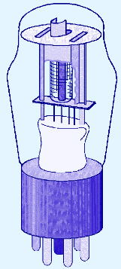
1st Generation Computers
Used vacuum tubes for logic and storage (very little storage available)
A vacuum-tube circuit storing 1 byte
Programmed in machine language
Often programmed by physical connection (hardwiring)
Slow, unreliable, expensive
The ENIAC – often thought of as the first programmable electronic computer – 1946
17468 vacuum tubes, 1800 square feet, 30 tons

Slide 27
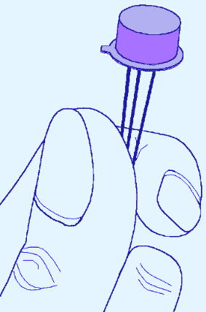
2nd Generation Computers
Transistors replaced vacuum tubes
Magnetic core memory introduced
Changes in technology brought about cheaper and more reliable computers (vacuum tubes were very unreliable)
Because these units were smaller, they were closer together providing a speedup over vacuum tubes
Various programming languages introduced (assembly, high-level)
Rudimentary OS developed
The first supercomputer was introduced, CDC 6600 ($10 million)

Slide 28
Second generation of computers Transistors
Replaced vacuum tubes
Smaller
Cheaper
Less heat dissipation
Solid State device
Made from Silicon (Sand)
Invented 1947 at Bell Labs by William Shockley et al.

Slide 29
3rd Generation Computers
ability to place circuits onto silicon chips
Replaced both transistors and magnetic core memory
Result was easily mass-produced components reducing the cost of computer manufacturing significantly
Also increased speed and memory capacity
Computer families introduced
Minicomputers introduced
More sophisticated programming languages and OS developed
Popular computers included PDP-8, PDP-11, IBM 360 and Cray produced their first supercomputer, Cray-1
Silicon chips now contained both logic (CPU) and memory
Large-scale computer usage led to time-sharing OS

Slide 30
4th Generation Computers 1971-Present: Microprocessors
Miniaturization took over
From (10-100 components per chip) to (10,000+)
Thousands of ICs were built onto a single silicon chip(VLSI), which allowed Intel, in 1971, to
create the world’s first microprocessor, the 4004, which was a fully functional, 4-bit system that ran at 108KHz.
Intel also introduced the RAM chip, accommodating 4Kb of memory on a single chip. This allowed computers of the 4th generation to become smaller and faster than their solid-state predecessors
Computers also saw the development of GUIs, the mouse and handheld devices

Slide 31
Microprocessors -Intel
1971 -4004
First microprocessor
All CPU components on a single chip
4 bit
Multiplication by repeated addition, no hardware multiplier!
Followed in 1972 by 8008
8 bit
Both designed for specific applications
1974 -8080
Intel’s first general purpose microprocessor

Slide 32
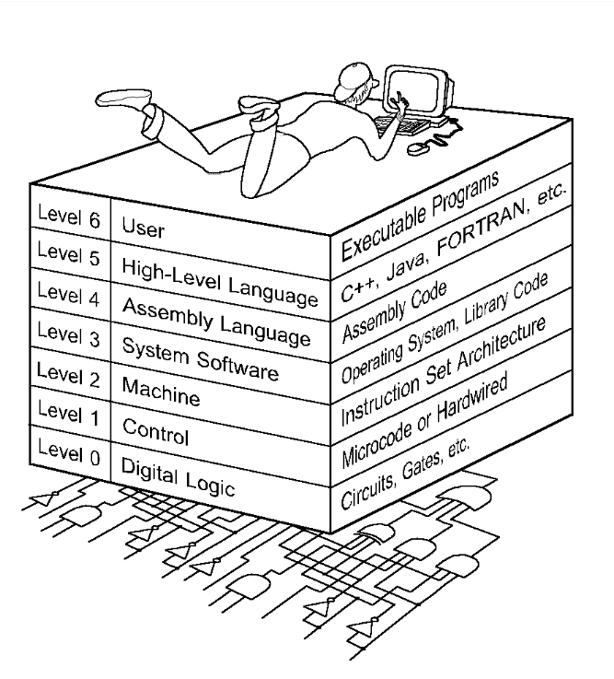
Computer Level Hierarchy

Slide 33
The Von Neumann Architecture
Named after John von Neumann, Princeton, he designed a computer architecture whereby data and instructions would be retrieved from memory,
operated on by an ALU, and moved back to memory (or I/O)
This architecture is the basis for most modern computers (only parallel processors and a few other unique architectures use a different model)

Slide 34
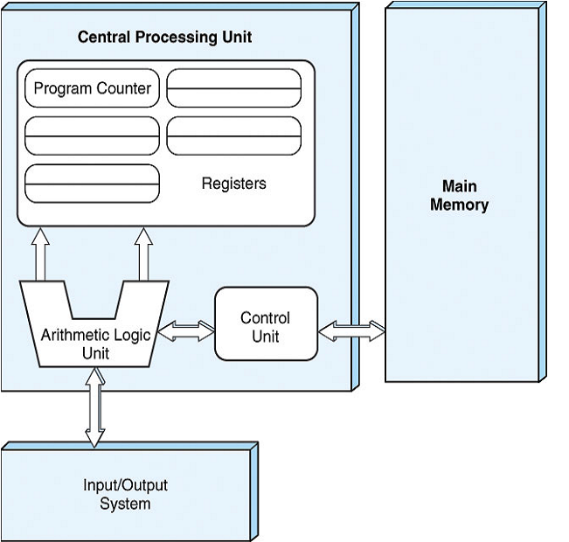
Hardware consists of 3 units
CPU (control unit, ALU, registers)
Memory (stores programs and data)
I/O System (including secondary storage)
Instructions in memory are executed sequentially

Slide 35
Von Neumann Architectures
There is a single pathway used to move both data and instructions between memory, I/O and CPU
the pathway is implemented as a bus
the single pathway creates a bottleneck
known as the von Neumann bottleneck
A variation of this architecture is the Harvard architecture which separates data and instructions into two pathways
Another variation, used in most computers, is the system bus version in which there are different buses between CPU and memory and memory and I/O

Slide 36
Fetch-execute cycle
The von Neumann architecture operates on the fetch-execute cycle
Fetch an instruction from memory as indicated by the Program Counter register
Decode the instruction in the control unit
Data operands needed for the instruction are fetched from memory
Execute the instruction in the ALU storing the result in a register
Move the result back to memory if needed

Slide 37
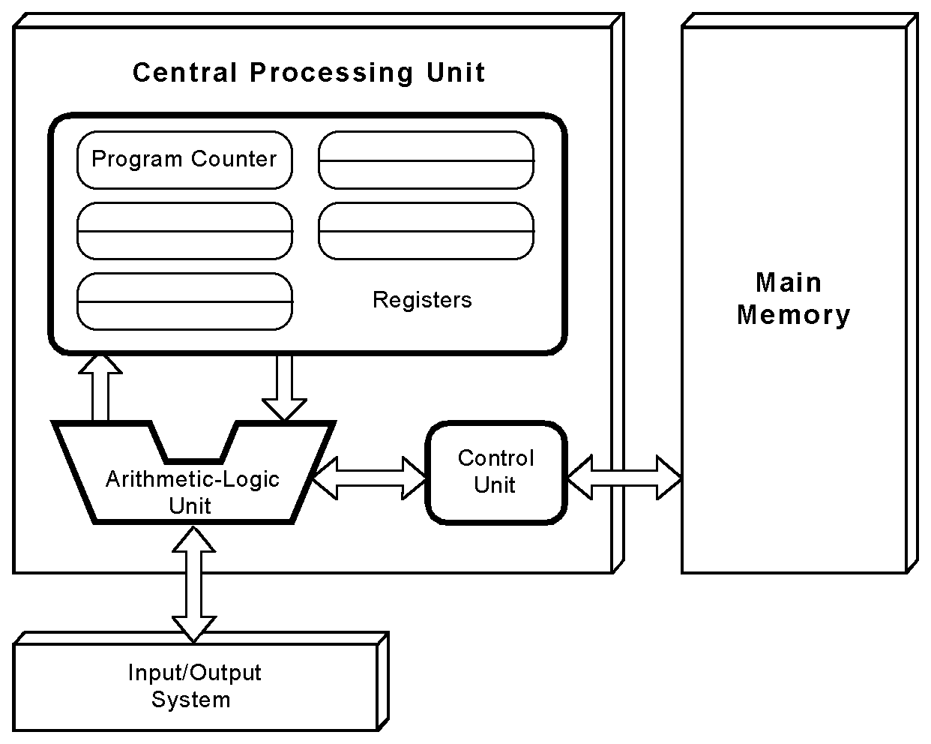
The von Neumann Model
This is a general depiction of a von Neumann system:
These computers employ a fetch-decode-execute cycle to run programs as follows . . .

Slide 38
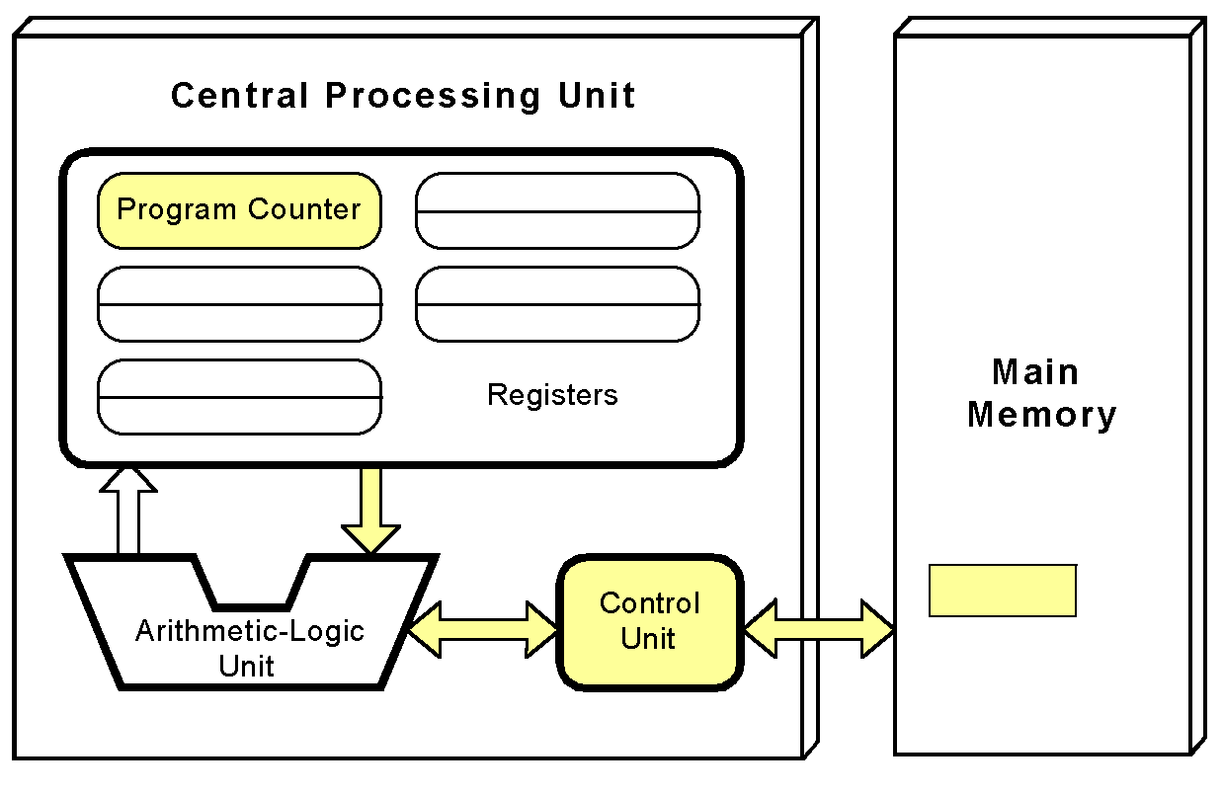
The von Neumann Model
The control unit fetches the next instruction from memory using the program counter to determine where the instruction is located

Slide 39
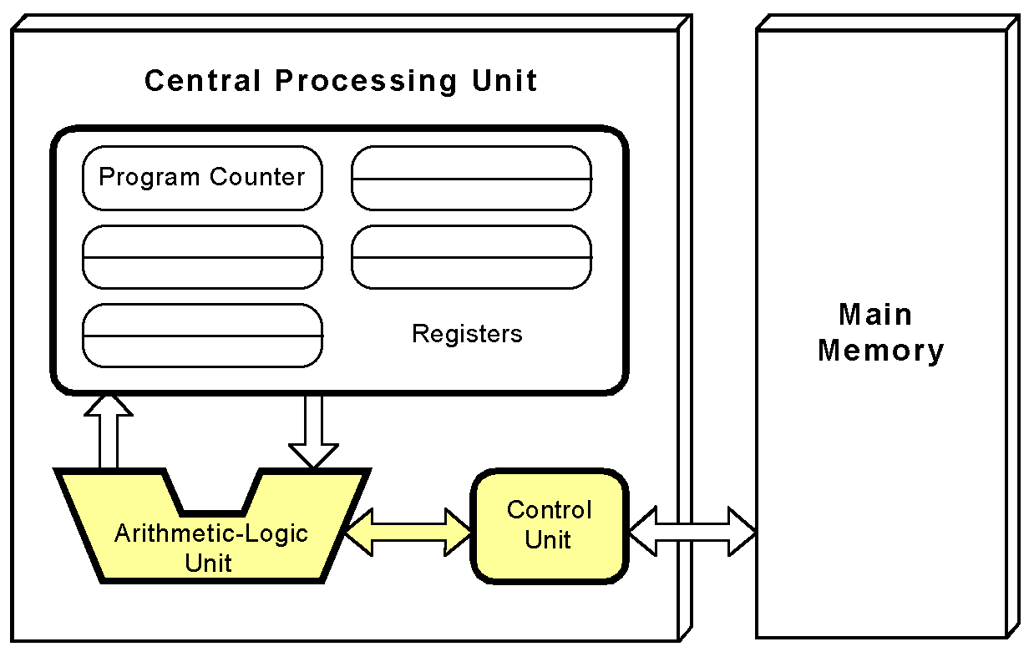
The von Neumann Model
The instruction is decoded into a language that the ALU can understand.

Slide 40
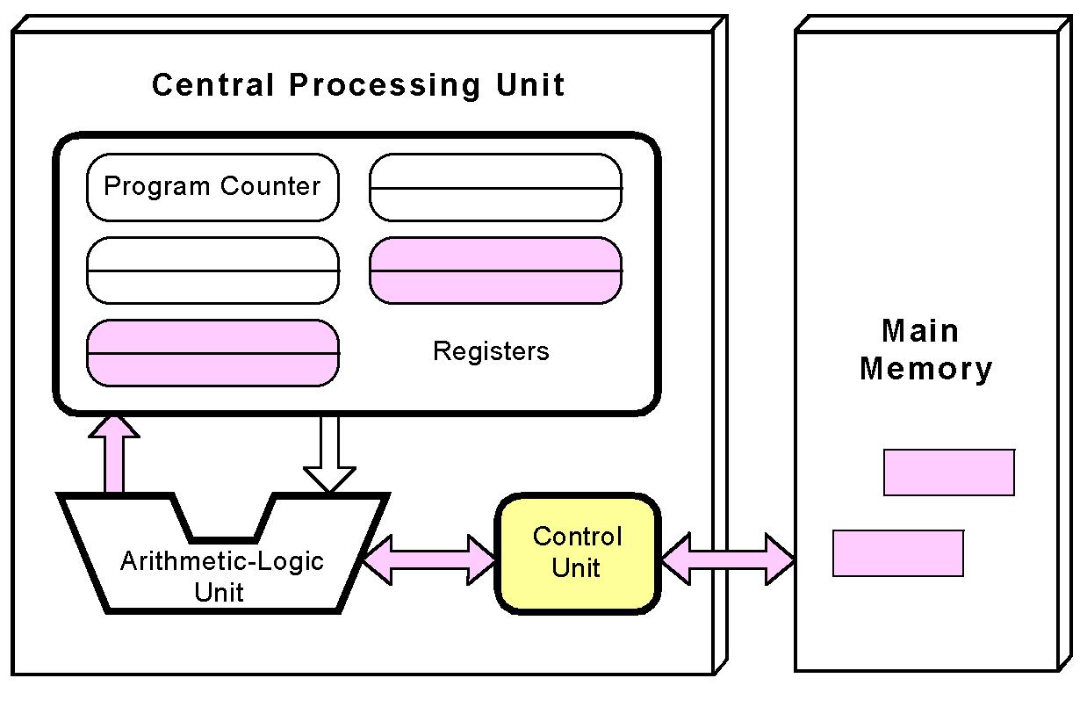
The von Neumann Model
Any data operands required to execute the instruction are fetched from memory and placed into registers within the CPU.

Slide 41
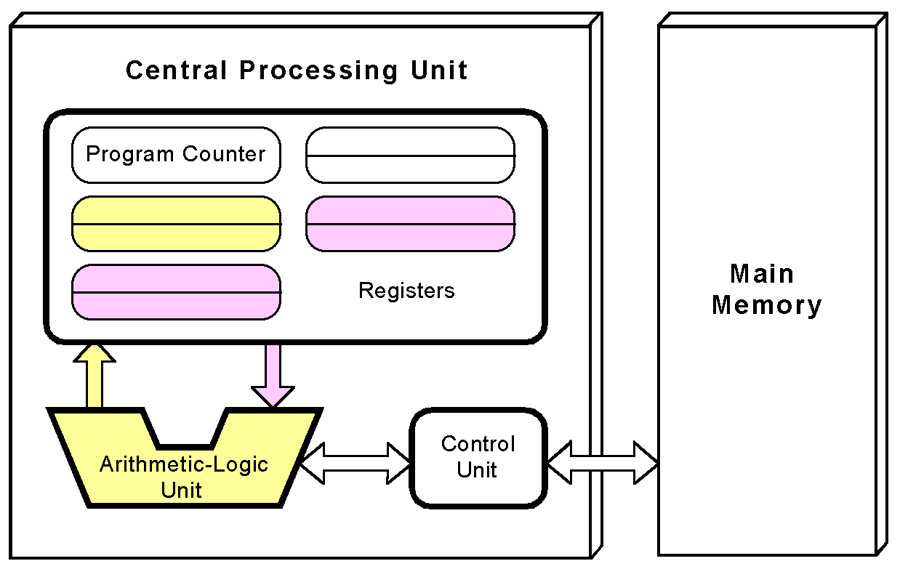
The von Neumann Model
The ALU executes the instruction and places results in registers or memory.

